Slide 1
Update from STFC
John Womersley
Astronomy Forum
Royal Astronomical Society
3 February 2015

Slide 2
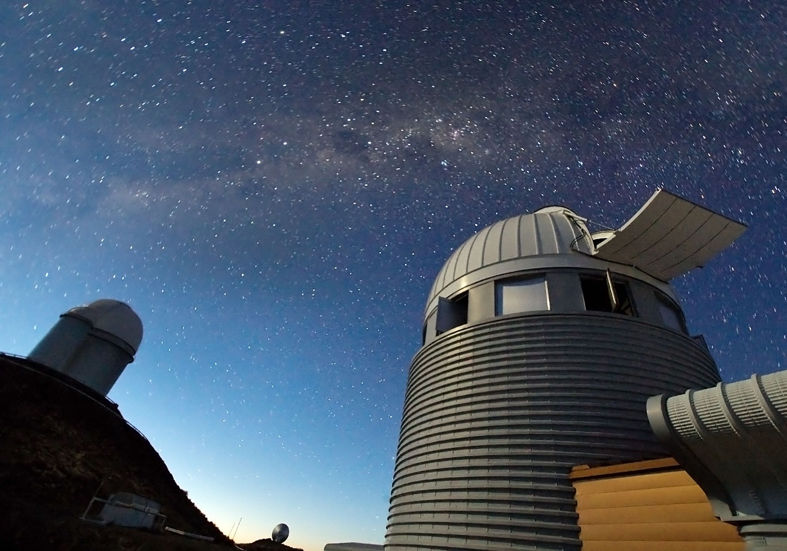
CONTENTS
    1. STFC news
    2. Pre-election situation
Credit: ESO

Slide 3

Astronomy updates
UKIRT and JCMT have been transferred
to University of Hawaii
STFC has made an award to allow
UK consortium continued access to
JCMT for 3 years
ING telescopes to be transferred to Spain (IAC) but STFC will continue to operate the facilities, focussing upon WEAVE
ESO Council has given go ahead for construction of E-ELT in two phases and major construction contracts will be let in 2015
  - Ratification of Brazil’s accession to ESO is still not complete.
STFC about to approve next phase of E-ELT instrumentation awards
Notes:
Handover of UKIRT to University of Hawaii took place in October 2014; operations by Lockheed and University of Arizona
Transfer of JCMT to University of Hawaii took place in January 2015; operations by East Asian Observatory
STFC have made an award to allow UK consortium continued access to JCMT for 3 years
ING telescopes to be handed over to Spain (IAC) but STFC will continue to operate the facilities on behalf of Spain, Netherlands and the UK community; still working through the details
Final Design Review for WEAVE planned for early 2015; multilateral agreement close to being signed
E-ELT
ESO Council have given go ahead for construction of ELT in two phases: phase 1 will cover the construction costs of fully working telescope and powerful suite of instruments (not a de-scope)
This plan is fully compatible with the UK programme for instruments which if approved by Science Board later this month, can go ahead as planned
Ratification of Brazil’s accession to ESO is still not complete
Continue to work with UKTI to ensure good returns for UK industry
Notes
2 phase development plan agreed at ESO Council in December 2014
The plan is not a de-scope of the telescope but a phased construction proposal, with some aspects deferred to phase 2 ensuring that the cost of Phase 1 is within that affordable from existing commitments from member states.
If funds are not available from Brazil the telescope built with only phase 1 systems would still be scientifically competitive, with the full angular resolution of a 39m aperture, but a lower sensitivity than the full system
Phase 1 includes a 39m diameter primary mirror, 4 of the 6 lasers for artificial guide star generation , the MICADO HARMONI and METIS instruments and the MAORY multi- conjugate adaptive optics system
Including €75M from Polish accession , ESO has 86% of the funding needed for Phase 1. In order to meet the 90% total funding requirement, previously set by ESO Council, the programme would need to be extended by another two years resulting in first light in 2026.
The new plan does not diverge from the previous plan until 2017 so there is still a chance to maintain the existing schedule towards first light in 2024 if Brazil ratifies its accession in the next 2 years.
This agreement is fully compatible with the UK programme and in particular means that both the HARMONI AND METIS instruments will go into full design and construction phases in 2015

Slide 4

SKA
£114M investment by the UK in SKA for HPC (Hartree)
UK leads on work packages (Manchester and Cambridge)
Rebaselining and outcome on (UK) HQ expected in March
Formal negotiations planned to begin April
BIS Gateway Review completed Nov 2014
Business case submitted awaiting approval from BIS
Construction set to begin in 2018
Credit: SKA Organisation

Slide 5
Refreshing our Science Programme
MOONS, an instrument for use on the ESO VLT
  £5.897M including contingency; awards to UKATC and Cambridge
  A UK-led project with 6 other international partners
DKIST, detector development for the Daniel K. Inouye Solar Telescope in Hawaii.
  £2.684M including contingency; consortium consists of UK academic institutions and industry
  Awards to Queens University Belfast, Armagh Observatory, University of Glasgow, Northumbria, Sheffield, St Andrews, Warwick
  working with DoE in the US and in collaboration with industrial partner Andor
DESI, development of optical fibre system and optical corrector
  £2.360M including contingency; UK buy-in for 4 years to DESI
  Awards to Portsmouth, Durham and UCL
  working with NSF and DoE in the US

Slide 6
UKSA
STFC works with UKSA to ensure maximum scientific impact from the exploitation of space missions via the AGP. STFC is providing strategic support for preparation of space missions such as Euclid, JUICE and JWST.
Cross-membership of committees
STFC has considered the case for ATHENA, reviewed proposals for ESA Cosmic Vision mission and is considering strategic science advice for the choice of M4.
UKSA intends to review its support for post launch support for existing UKSA missions (ESA, NASA, JAXA) and STFC will provide strategic advice.
UKSA is participating in the STFC review of Exoplanet research

Slide 7
Consolidated Grants
Implementation Review
Looked at implementation and areas for improvement
Met with PP grant holders in September to discuss recommendations
Key changes for PP/NP (already in place for Astronomy)
  No overlapping grants
  Three-year awards with review dates brought forward to preserve long-term planning and security for core posts
  Scope for a no-cost extension of up to one year
  Improvements to operating effectiveness
  (e.g. simplifying grants processing)
Key change for Astronomy
  two calls for grant proposals: Astronomy Observation/Astronomy Theory and Solar Studies/Planetary Studies
Notes:
Not a significant change for PPGP(T) or Astronomy who already work in this way
Bigger effect for the next PPGP(E) CG round 2015

Slide 8
Changes to Pathways to Impact
RCUK recently undertook a review of Pathways to Impact in consultation with representatives from the academic and user communities and have listened and responded to these recommendations. The review reaffirms our commitment to Pathways to Impact and minor amendments have been made. http://www.rcuk.ac.uk/ke/impacts/
Key changes:
Better guidance on Pathway to Impact statements
Grants will not be allowed to start until a clearly thought through and acceptable Pathways to Impact statement is received.
Notes:
Note: We are implementing for applications after 1st April, not grants starting from 1st April

Slide 9
Review of Open Access Implementation
Chaired by Sir Robert Burgess, representation from universities, libraries, learning societies, publishers & funders
Reviewing the implementation and effectiveness of the RCUK policy over the period April 2013-July 2014
The panel is undertaking visits to institutions during January.
Final report due to be submitted to the RCUK Executive Group in March.
Notes:
Emerging findings:
Universities have had difficulties providing the reporting information requested by the Research Councils, so compliance is difficult to assess.
The RCUK preference for gold open access publication may not be appropriate in all areas.
The distribution of block grant funding to universities has created significant administrative challenges within universities.
It is important to ensure that there is alignment between the RCUK and REF policies on open access.
More work is needed to understand issues around embargo periods and licensing arrangements, particularly discipline-specific differences.
Further block funding in support of the policy implementation will be issued to universities to cover 2015/16. Funding beyond that will be subject to the outcome of the review.
In parallel, STFC is contributing €230,000 in each of 2015 and 2016 to the Sponsoring Consortium for Open Access Publication in Particle Physics which enables particle physics papers to be published without direct cost to either author or reader.

Slide 10
Nominations Exercise
Membership of STFC’s standing advisory committees and panels (including its peer review panels) is reviewed annually.
The community is invited to make applications and nominations for membership of these bodies.
The ‘nominations exercise’ for 2015 will shortly be announced.
Information will be available from the STFC website and will be publicised via the community mailing lists.
Notes:
If anyone has any queries about the nominations exercise, they can contact Trish Mullins.

Slide 11
CONTENTS
  1. STFC news
  2. Pre-election situation
Credit: ESO

Slide 12
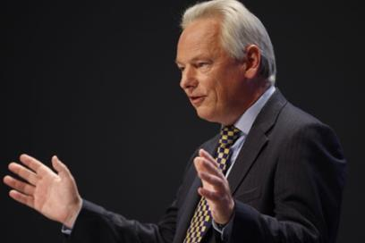
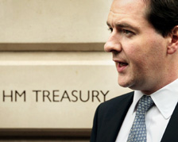
The Big Picture
Pressure on funding
Autumn statement announced flat capital budget to 2020
  Capital requirements of upgrade programmes at International Subscriptions will create additional pressure
Spending Review to determine resource funding to 2020
  Research Council capital allocations will resolved in parallel
Notes:
The Chancellor of the Exchequer George Osborne gave his annual Autumn Statement to Parliament on 03 December 2014. He said to the House of Commons, “today we boost our skills, our exports, our science, our infrastructure,” and described science as “a personal priority of mine as Chancellor.”
Announcements related to Science:
Loans for postgraduate masters
From 2016-17, income-contingent loans will be available for postgraduate taught masters courses in any subject for those under the age of 30.
The loans, of up to £10,000, will beat commercial rates.
This will mean that more people will be able to take advantage of postgraduate courses, including those from low income backgrounds.
£5.9 billion sustained investment in science
The Government will invest £5.9 billion into the UK’s research infrastructure over 2016-21. This funding will include a £2.9 billion Grand Challenges fund, which will enable the UK to invest in major research facilities of national significance. This strategy commits £0.8 billion of this to major new research facilities and projects including:
£235 million in the advanced materials Sir Henry Royce Institute;
£113 million in a Cognitive Computing Research Centre at STFC’s Hartree Centre, Daresbury, which will enable non-computer specialists to gain insights from big data in order to enhance and design products, services and manufacturing processes;

Slide 13
We Have Come a Long Way
2010
2014
“The STFC: what went wrong” (New Scientist blog, Feb, 2010) BIS imposes special measures to ensure STFC will deliver
“Debt crisis threatens UK science” (Nature, Jan 2010)
“STFC cuts will lead to `brain drain’, claim scientists” (Times Higher Education,
Jan 2010)
“UK science faces facilities freeze” (Nature, Dec 2010)
Released from BIS special measures, budgetary control, trusted partners.
Admin costs driven down without interruption to service
Science facilities remain world class, e.g. TS2 competes with MW facilities elsewhere
Refreshed science programme, e.g. E-ELT, FAIR, ESS
International engagement developed – ESFRI, SKA, Horizon 2020, etc.
Delivered major investment on Campuses, e.g. Hartree, Space Cluster development – Catapult, ESA development

Slide 14
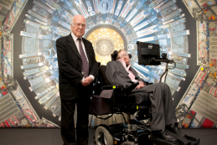
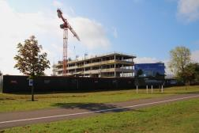
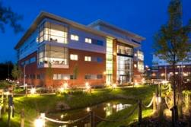
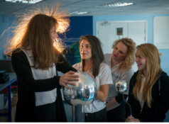
  World Class Research
  Higgs boson, Rosetta, Planck, Foot and Mouth Vaccine…
  World Class Innovation
  Daresbury, Harwell, Incubation centres, Hartree…
  World Class skills
  Inspiring the next generation, engaging the public, working with industry, technical training

Slide 15

Spending Review – likely timeline
Civil service discussions for Spending Review are underway now
  Initial data request likely March 2015?
Election – May 2015
  New Government, Chancellor, Ministers?
  Departmental reorganisation?
  Input from Nurse Review?
Government Dept CSR15 - June to Oct
  If coalition re-elected, Spending Review
  may be delayed as 2015/16 resource
  already agreed
  If minority Government elected, it may be a one year roll-over and second election
RC allocations – Oct to Dec?

Slide 16
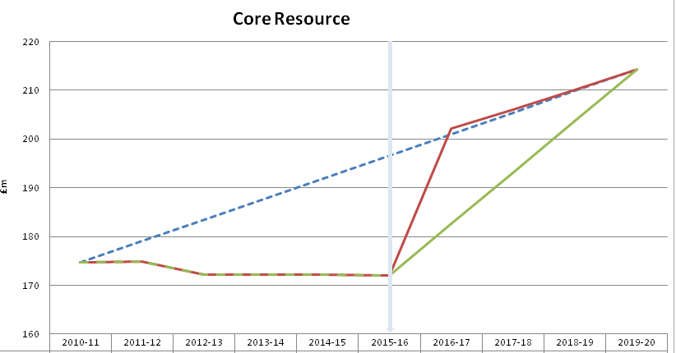
Scenario Development
Looking to close the gap on the lost decade
Modelling potential scenarios for International Subscriptions, Facilities and Core Programme
  +25% to -25% with implications and consequences
  Modelling resource and capital
Wide range of inputs, e.g. Programmatic Review, foreign exchange movements, Impact Reports

Slide 17

CSR15 – Our offer
What we can offer in the next four years
Data-intensive science - Connecting science to economic growth through work in research (SKA, CERN, facilities), innovation (Hartree) and skills (new training proposals)
  Imaging – visualising data essential for industry in major industrial country
  Materials – understanding new materials enhancing engineering
  Strategic development of technology
  Strategic planning of facilities

Slide 18
CSR15 – Our ask
What we will need
Funding: flat cash is not good enough
  Ideally should restore real-terms losses since 2010
International subscriptions: needs to cover existing and new pressures, forex risk, capital programme etc
Large facilities: maintain the uplift from 2015/16 plus include the batteries
Core programme: restore losses and provide uplift to develop strategic technology to assist UK growth

Slide 19
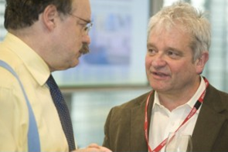
Science and Innovation Strategy
  Vision for the UK to the best place in the world for science and business
  Sir Paul Nurse to review Research Councils and report to BIS
  Not a Royal Society Review
  To be carried out with the RCs but not by the RCs
  Proposed names for panel with Minister for sign off
  Will be supported by wider group of 20 covering all interests
  Devising a “light touch” consultation
  Unlikely to report by June

Slide 20
Nurse Review TORs
To examine, and provide recommendations on, how RCs can evolve to support research in the most effective ways, reflecting the requirements to secure excellence, promote collaboration and allow agility, and in ways that best contribute to sustainable growth:
  Is the balance between investigator-led and strategically-focused funding appropriate, and do the right mechanisms exist for making strategic choices?
  Within each Research Council is the balance of funding well-judged between support of individual investigators, support of teams and support of equipment and infrastructure?
  How should the Research Councils take account of wider national interests including regional balance and the local and national economic impact of applied research?
  Is the balance of funding between different Research Councils optimal?
  Do they adequately support interdisciplinary research?

Slide 21
Nurse Review TORs (cont’d)
  Are the right arrangements in place to ensure optimal funding for research that crosses disciplinary boundaries?
  Are the divisions of scientific subject areas between the research councils appropriate?
  What are the gaps or holes in the funded portfolios of the research councils?
  How can the RCs catalyse collaboration between institutions?
  Should the funding of research councils be directed almost exclusively to the university sector, with organisations such as the Meteorological Office, the Health and Safety Laboratories and the National Physical Laboratory out of scope?
  How should the work of the research councils integrate most effectively with the work of agencies funding innovation, such as Innovate UK, and with the work funded by Departmental research and development budgets?

Slide 22
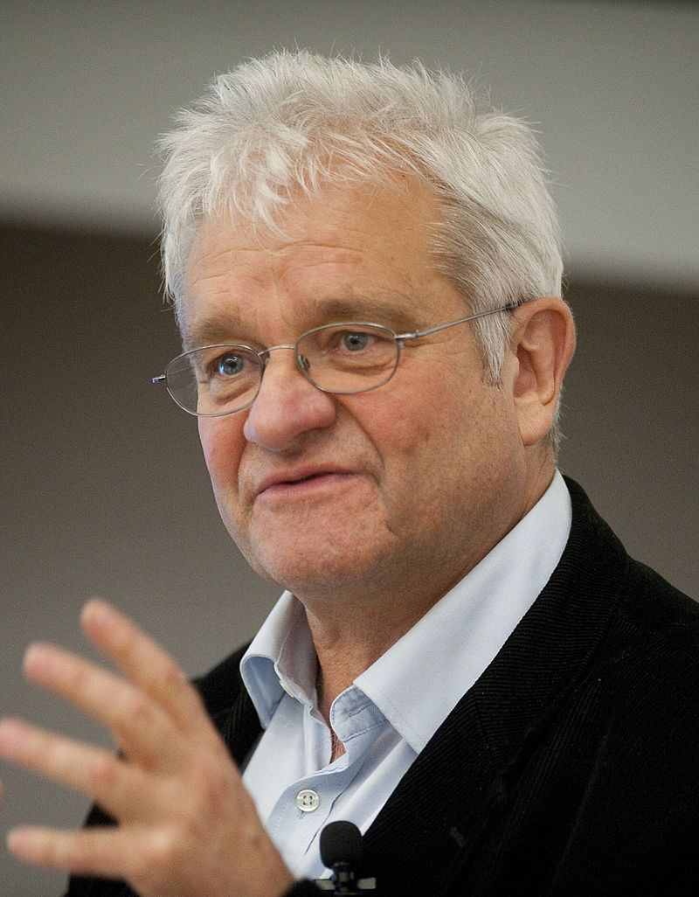
Different to CSR
  “May require new capabilities and structures. . .”
  Structural things, processes or ways of working
  Need to be thinking future health of the system
  We could deliver more and better, if . . .
    ‘Batteries are included’?
    Longer-term funding for strategic programmes
    Better way of tensioning between disciplines?
    Better advice for Global Challenge investments
    Capital funding accompanied by resource?
    . . . ?

Slide 23
How you can help
Deliver what we have promised
  Our plans, targets and projects
Help our stakeholder relationships
  Other Research Councils
  Business
  International
Help to gather evidence and articulate our success
  Help us make the case for the importance of what we do
… and keep delivering great science programmes!

