Slide 1
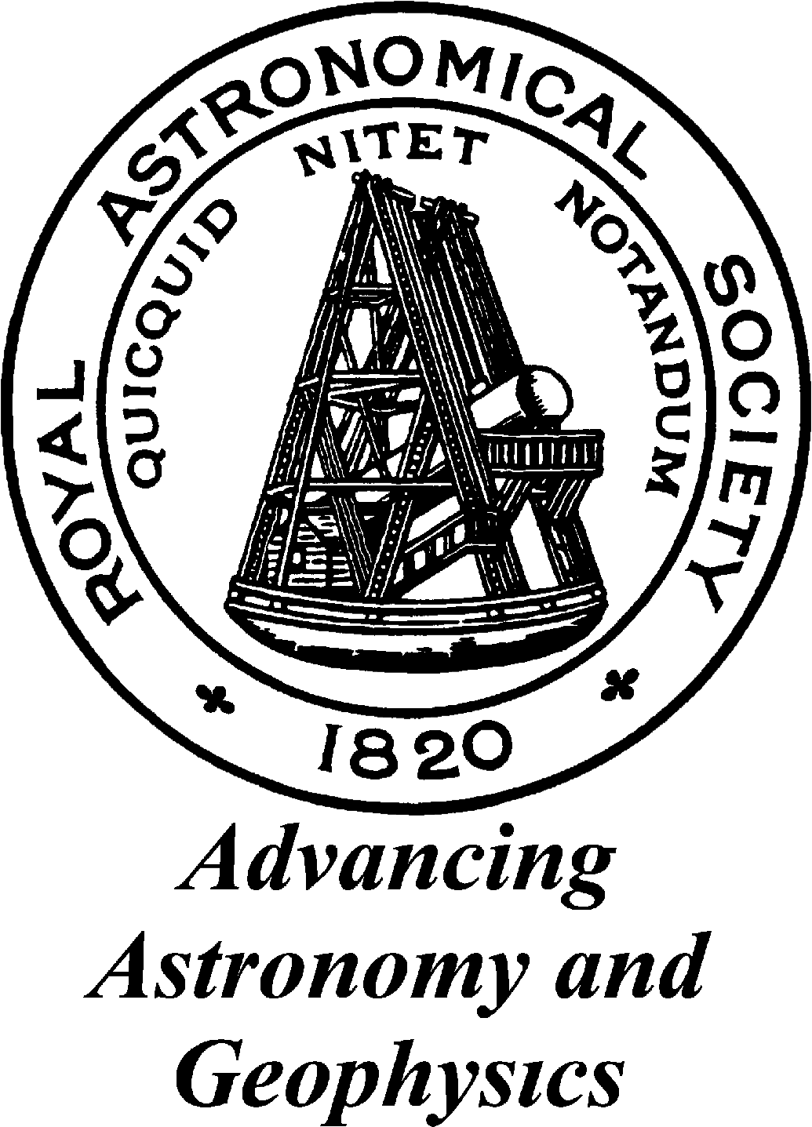
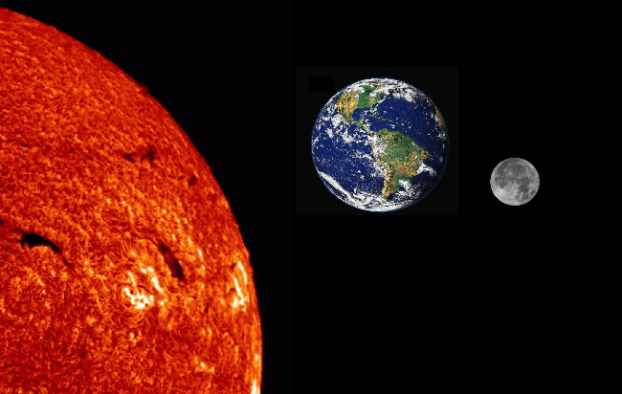
The effects of the Sun and the Moon on the Earth

Slide 2
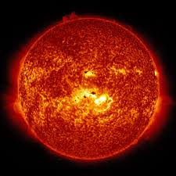
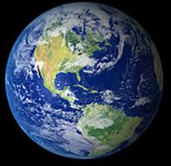
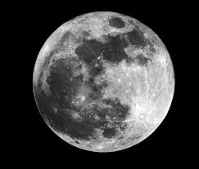
Sun, Earth, Moon system
Notes:
The Moon rotates around us (in about 27 days), but we rotate around the sun (in about 365 days)!

Slide 3
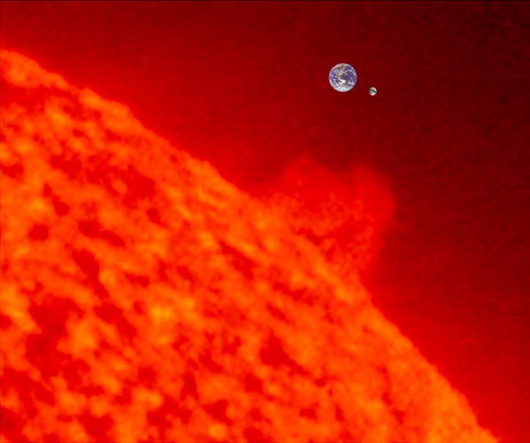
Scale of the Earth, Moon, and Sun
@hyperphysics
Notes:
http://hyperphysics.phy-astr.gsu.edu/hbase/Solar/moonscale.html
This is how big the sun is compared to earth (the big blue dot) and the moon (the tiny grey dot)

Slide 4
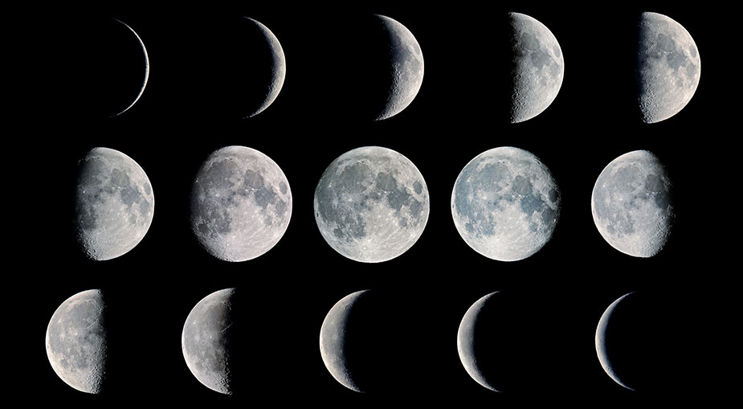
Phases of the moon
Notes:
https://www.youtube.com/watch?v=wz01pTvuMa0
this video shows how to demonstrate the phases of the moon using a lamp, a foam ball, a pencil and a darkened room.

Slide 5
https://moonphases.co.uk/moon-phases

Slide 6
Tides
Notes:
https://www.youtube.com/watch?v=4UZxzyOVJ8Q
Brian Cox explains the tides – the gravitational pull of the moon pulls the water on the surface of the Earth towards it. The spinning of the Earth causes a (centrifugal) force just like when you spin around really fast around a round-about causing a bulge on the other side of the earth aswell! That’s why we have two tides per day.

Slide 7
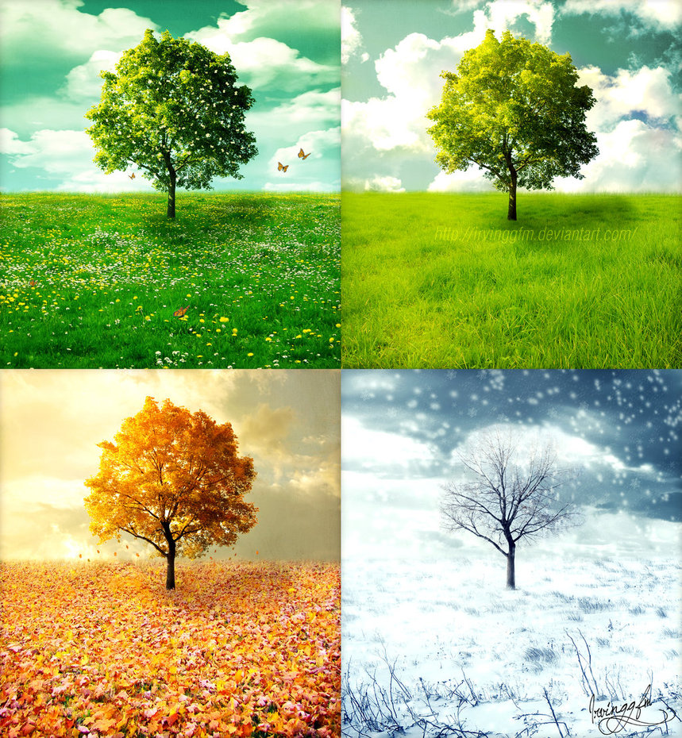
Why do we have four seasons?

Slide 8
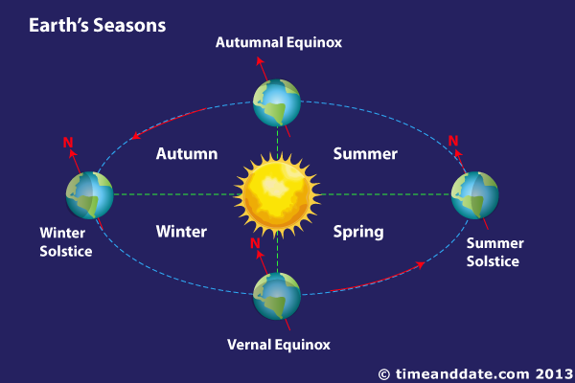
Notes:
https://www.bbc.co.uk/education/clips/z6vfb9q This is a nice simple BBC video to explain the seasons.

Slide 9
Videos in notes
https://www.youtube.com/watch?v=wz01pTvuMa0 this video shows how to demonstrate the phases of the moon using a lamp, a foam ball, a pencil and a darkened room.
https://www.youtube.com/watch?v=4UZxzyOVJ8Q Brian Cox explains the tides
https://www.bbc.co.uk/education/clips/z6vfb9q This is a nice simple BBC video to explain the seasons.

