Slide 1
STFC Astronomy Advisory Panel report
RAS Astronomy Forum
6th February 2020
Stephen Serjeant (AAP chair) on behalf of:
James Bolton, Poshak Gandhi, Christiane Helling, Paolo Mazzali, Stephen Serjeant, Ben Stappers, Yvonne Unruh, Aprajita Verma

Slide 2
What the Priority Projects call is:
a call for ideas
What the Priority Projects call does NOT have:
money
What the Priority Projects call is NOT:
a mini Decadal Review
Notes:
This was a call for project proposals in 2018. Remember though what the Priority Projects call is: A CALL FOR IDEAS, nothing more, so STFC can wave them under the nose of a minister if there’s money to be had, or work something up for Research England or some other short-notice scheme if there’s an opportunity. What the Priority projects call does NOT have though is MONEY. There is no cash to bid for here. Also, what the Priority Projects is NOT is a mini Decadal review. Having something in this list doesn’t mean that it’s somehow baked in stone as a top priority, irrespective of its science case for whatever call it’s being considered in. There’s a separate process for that in the Balance of Programmes reviews.

Slide 3
Your top priority:
GRANTS
Out of scope for Priority Projects:
GRANTS
Notes:
Because, your top priority is not any of these Priority Projects. Your top priority is GRANTS. But out of scope for the Priority Projects is GRANTS.

Slide 4
AAP PRIORITY PROJECTS 2018
Simons Observatory
New Robotic Telescope (LT2)
GOTO
Next generation ultra-sensitive receiver systems for ALMA
The receiver factory; SKA band 5 receivers for MeerKAT, AVN and e-MERLIN
Tried to cover breadth of AAP interests
Tried to capture top priority / strongest science in each area
Did we succeed? You tell us!
Notes:
Here are the 2018 AAP priorities, in no particular order. We tried to cover the breadth of AAP interests, from CMB to gravitational waves to optical to mm to radio. We tried to capture the top priority or strongest science in each area. This was easy in some cases, for example for the CMB their top priority is the Simons Observatory, and that community has been very organised in town hall meetings and white papers to decide this top priority. So that one was easy. But for the rest – did we succeed? You tell us! That’s what this light-touch review is for.

Slide 5
AAP PRIORITY PROJECTS 2018 THAT GOT NEW £:
Simons Observatory
New Robotic Telescope (LT2)
GOTO
Next generation ultra-sensitive receiver systems for ALMA
The receiver factory; SKA band 5 receivers for MeerKAT, AVN and e-MERLIN
Notes:
Here are the ones that actually secured new money.

Slide 6
AAP PRIORITY PROJECTS 2018 THAT GOT NEW £:
Simons Observatory
New Robotic Telescope (LT2)
GOTO
Next generation ultra-sensitive receiver systems for ALMA
The receiver factory; SKA band 5 receivers for MeerKAT, AVN and e-MERLIN
NONE OF THEM
Notes:
None of them.

Slide 7
AAP PRIORITY PROJECTS 2020
A combined radio project, augmenting the existing SKA band 5 Priority Project with UKNRAO, eMERLIN+ and Phased Array Feed, to create a single long-term visionary proposal for radio astronomy.
Next Generation Ultra-Sensitive Receiver Systems for ALMA
New Robotic Telescope
A combined exoplanets observation and modelling project, to create a single long-term visionary proposal for exoplanet atmosphere characterisation: From JWST to METIS; ExoMet; ELT Planetary Camera and Spectrograph; Precision wide-field spectrograph for atmospheric characterisation of exoplanets from the ground; Planetary Atmosphere Machine
A Dedicated Wide-Field Spectroscopic Survey Telescope
Notes:
So, we tried to rejig this, in the hope that things that look more thematic could have a bigger chance of success. Again these are in no particular order.

Slide 8
AAP PRIORITY PROJECTS 2020
Simons Observatory & GOTO: This is in no way a reflection of any lack of support from AAP, nor has AAP's view on their high strategic importance changed.
Simply reflects what we now think might have a better chance when pitched externally to policymakers beyond the science community.
There will be opportunities to introduce the former Priority Projects, and others, in the revised Technology Roadmap that AAP will be developing with your help over the coming year. Process TBD but will probably be joint with SSAP.
Notes:
[read]

Slide 9

AAP, SSAP, PAAP suggest:
Do it like EPSRC (big ideas or themes rather than projects)?
Coordinate with UKSA?
£ for consortium building?
Notes:
Several of the advisory panels have gotten together to look at the priority project process and we had a few ideas, which I think are being considered by STFC, but UKSA and STFC folk can comment directly here.

Slide 10
}
2020 UPDATES?
Other evaluation panels
BALANCE OF PROGRAMMES REVIEW 2, 2020
AAP:
community survey 2018/2019
Astronomy Evaluation Panel 2019
Other evaluation panels
Notes:
Onto the other main activity: the bop2. Here, we polled the community a couple of years ago, this fed into the AEP that has published its results at the end of last year, and together with the evaluations in other fields, these feed into the bop2. But the advisory panels have one last chance now to provide any updates.

Slide 11
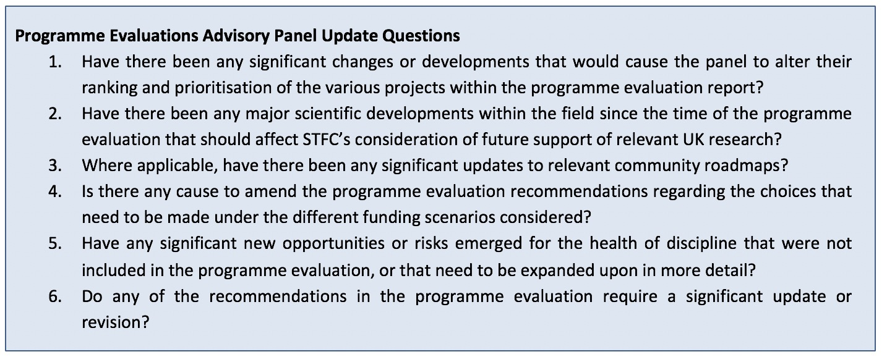
AAP answers due 17th Feb 2020... so please alert us ASAP to any material changes that would affect AEP conclusions and hence BoP2
Notes:
Here is the brief we’ve had from STFC. I’ll leave this slide up there. I don’t think a lot has changed in the past four months or so, but if you know of some news that would have materially changed the AEP report then please let us know ASAP.

