Slide 1



STFC Update
RAS Forum
Professor Mark Thomson
Executive Chair
29 November 2022
Notes:
The abstract pattern can be removed or repositioned if required. Be careful to ‘Send to Back’ so that it does not obscure any important information.

Slide 2


General Update
Notes:
The abstract pattern can be removed or repositioned if required. Be careful to ‘Send to Back’ so that it does not obscure any important information.

Slide 3

Strategic Delivery Plan
STFC’s new Strategic Delivery Plan was published, alongside other Council Delivery Plans, on 2nd September
Sets out STFC’s exciting plans for the next three-year spending period
Many new activities and investments across all STFC areas
Explains the role STFC will play in delivering UKRI’s wider mission/vision
Structured around the six objectives of the UKRI Strategy
Links to updated STFC Strategy Map
Incorporates many suggestions from Council – thank you.

Slide 4

Our ambitious plan: Ideas and Places
Major investment and activity across STFC, examples include
An increase of £19 million over the next three years for STFC-supported frontier research programmes – significant uplift to CGs
Enhancing UK scientific links globally, initially targeting new scientific collaborations with India, Japan and the US. Initially this will include funding the Hyper-Kamiokande neutrino experiment in Japan and the US Simons Observatory (located in Chile)
Delivery of a portfolio of infrastructure projects to provide the capability to enable the UK’s thriving research and innovation communities to address the most pressing industrial and societal challenges
  Includes major investments in all our large multi-disciplinary facilities (CLF, Diamond and ISIS)

Slide 5
Our ambitious plan: Innovation and Impact
Major investments and activity across STFC, examples include
Investment in a pipeline of novel technologies (including digital technology, artificial intelligence and quantum technology) – from blue skies research through to support for commercialisation and start-up opportunities – new “PRD-like” scheme rising to £2.5m p.a.
Fully exploit the £132 million investment in the HNCDI including the establishment at least three regional SME hubs across the UK
Invest £7.5 million in a new ‘AI for Science’ initiative within our Scientific Computing Department – and aim to collaborate with similar initiatives at the US Department of Energy’s national laboratories
Grow our links to business and industry at our Research and Innovation campuses

Slide 6
Our ambitious plan: People and Careers
Major investment and activity across STFC, examples include
Supporting the development of a pipeline of skilled engineers and technicians in strategically important sectors by investing £2.5 million in Phase 1 of the STFC Skill Factory to more than double the intake of apprentices working at our world leading facilities by 2025
An investment of £4.2 million in public engagement, expanding our reach and impact by utilising our early-career staff, including apprentices and graduate intakes, to deliver over 1,500 days of direct community-focused activities
Increase our support for early-career university researchers working on our core scientific mission
Action-focused Equality, Diversity & Inclusion plan

Slide 7
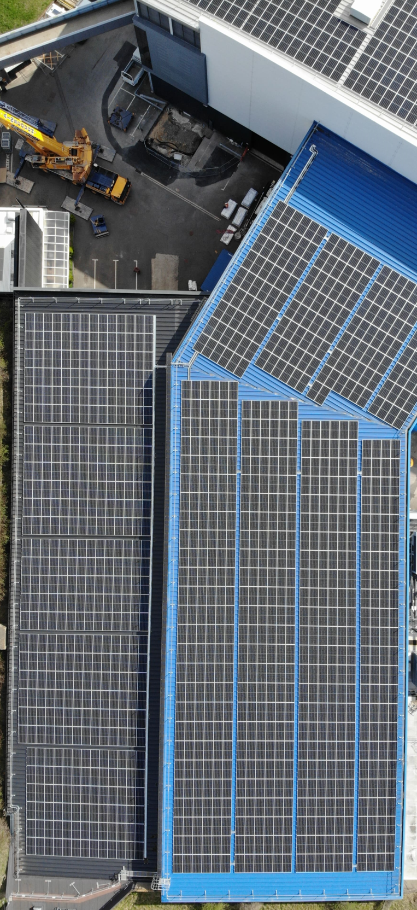
Our ambitious plan: Organisation
Investment and activity across STFC, including
We aim to embed environmental sustainability in all STFC operations, estates strategy, research, supply chains and projects to enable us to meet our Net Zero objectives and UKRI’s Environmental Sustainability Strategy, as part of our plan to transition to net zero operations by 2040
Deliver a programme of power consumption reduction activities and develop an Energy Roadmap for the RAL site to assure continuity and sustainability of supply
  Photo Voltaic (PV) on ISIS will provide c1.5% of electricity used p/a
Increase biodiversity on our campuses to make a positive contribution to the environment by developing a Biodiversity Action Plan

Slide 8
Inflation & energy costs
Pressures being felt across both UK programmes and portfolio of international research facilities we support
      UK Challenges:
        Inflationary pressures on infrastructure costs are >> CPI
        Supply chain challenges are slowing ability to spend
        Current and future energy costs are hard to predict
      International Challenges (CERN, ESO, SKA, ESS, ILL, ESRF, Eu-XFEL):
        Most international organisations requesting between 3% and 4% indexation
        STFC budget assumptions in Spending Review request of 2%
          there could be a gap between what is agreed internationally and funding available
          exploring ways to mitigate this risk

Slide 9
Horizon Europe Update
Current position:
      Association remains the preferred option
      The Guarantee is being delivered, with over 1164 applications registered (31 October) and the value of grant letters issued totalling £512m
      In addition, UKRI will be delivering a £280m package of investment providing further support for the R&I sector. This includes £12m Digital Research Infrastructure
      UKRI is working with BEIS on alternatives if association is not possible

Slide 10
Aside: Strategic Review of Particle Physics
Light-touch Strategic Review of Particle Physics:
Prime aim was to consider how to best ensure the long-term health of PP in the UK
This was not a project prioritization exercise
      Now complete. Draft report discussed at STFC Council in September
      Action and implementation plans are under development – plan to publish report with high level statement, followed by more detailed plan at a later stage
      A number of positive steps have already been taken:
        A commitment to uplift the underpinning grants built into the 10-year financial model
        Recent funding calls to support CG research posts and early-stage R&D
        Improved project management support
        Undertaking an internal review of governance structures underway including provision of strategic advice

Slide 11
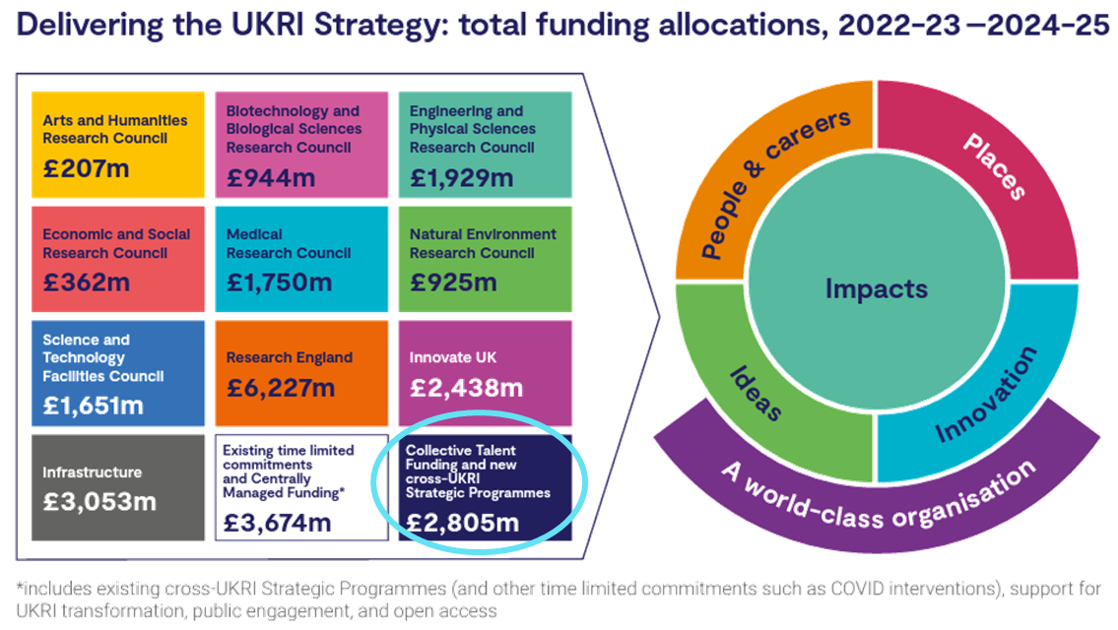
UKRI & Collective Talent Funding
UKRI will transition to collective working across £2bn of talent initiatives:
      Mainly covers studentships & fellowships
      Roadmap is planned to be published externally in December with an accompanying blog
      A stakeholder engagement strategy is also being developed
      There are no immediate changes to council planned funding opportunities
      UKRI announced that it was increasing its minimum stipend from 1 October 2022 to £17,668 full time equivalent. This is a 10% increase
      Discussions are ongoing about potential future increases in stipend
      STFC Council steer that we should maintain the student to programme balance

Slide 12
Fellowships and Studentships
Dual role – supporting research and development of the individual
    Earnest Rutherford Fellowships (ERF) – call closed in September with 170 applications, so please encourage colleagues to help with reviewing etc. Panels will be held early in the New Year.
    Future Leaders Fellowship - Round 7 Outline call closed in October. 561 outlines were received in total. The full call closes on 6 December.
    Stephen Hawking is now open. Now being operated by EPSRC as an open rolling round so please encourage colleagues to submit applications as soon as they are ready to apply
    Call for UKRI AI CDT will go live soon and community should consider applying
    ETCC will be consulting the community about skills needs

Slide 13
Fellowships Update
Overall picture remains relatively healthy
    Earnest Rutherford Fellowships (STFC):
      1 round every year
      40 fellowships awarded since 2019
    Stephen Hawking Fellowships (EPSRC/STFC)
      10 in 2020, 11 in 2021
      16 in STFC-related fields
    Future Leaders Fellowship (UKRI)
      ~2 rounds
      44 fellowships awarded in STFC-related fields since 2019
    Daphne Jackson Fellowships:
      2 fellowships currently awarded

Slide 14
Astronomy Highlights
Notes:
The abstract pattern can be removed or repositioned if required. Be careful to ‘Send to Back’ so that it does not obscure any important information.

Slide 15
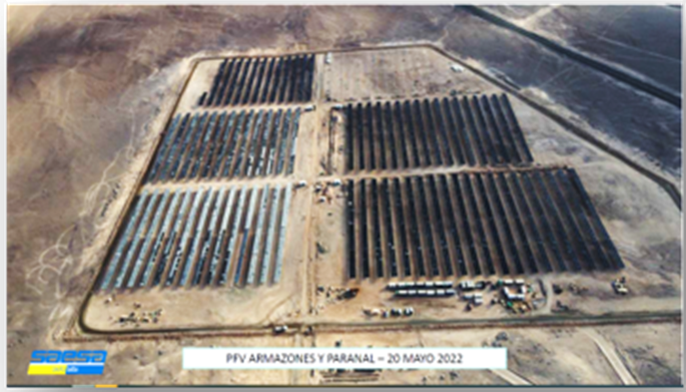
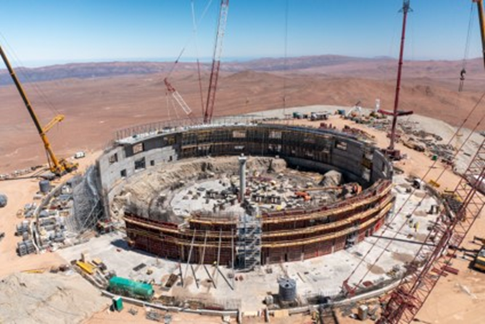
ESO
Headlines
    ELT: construction work in Chile ramping up with most of the materials for the dome delivered to site.
    ESO: operational and development costs are increasing – in common with most infrastructures in face of inflation. Full impact not clear, but likely to be felt downstream
    MOONS: making huge steps and on track for acceptance in at end of 2023
    HARMONI: red flag issues mostlty resolved but need ESO advisory committee’s adoption. ESO and HARMONI on same page so hope work can get back up to full speed
    STFC’s PPRP reviewing all ELT development programmes, including MOSAIC and ANDES.

Slide 16
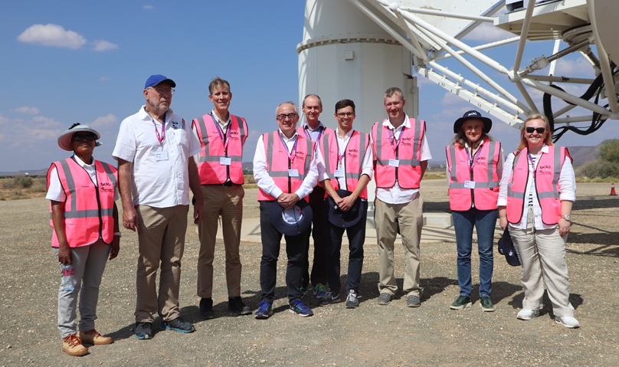
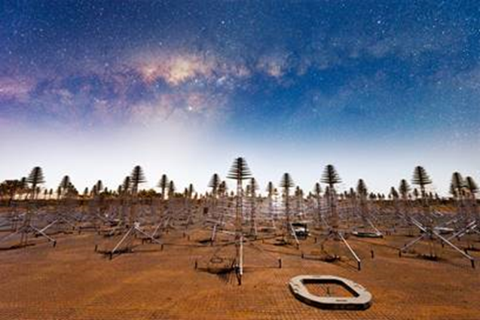
SKAO
Headlines
    SKAO Council met in South Africa in November
      voted for German accession
      Council visit to the Karoo
    Contracts for UK in-kind construction work are proceeding apace
    UK SKA Regional Centre - awards up to £7.2M being prepared
    Commencement of construction ceremonies at telescope sites in December
Notes:
Top: SKAO hosts at site in SA
Bottom: Aperture Array Verification System in Australia

Slide 17

Space Science
Headlines
    STFC and UKSA chief execs meet every few months to coordinate high level priorities – including development of space clusters, roll out of NSTF, etc.
    Over £400k invested by STFC and UKSA in novel technologies for future space missions in 2021. New scheme worth £1.6M for early TRL technology related to future space science instrumentation R&D open now
    STFC will be engaged with selection process for bi-laterals
    STFC continues to invest in space mission early preparation studies – community building, travel, modelling etc. Over £0.4M committed in 2022 including SMILE, EnVision, OSIRIS-Rex, Solar-C plus Webb Fellows.
Notes:
Pic is Hourglass galaxy imaged in IR by Webb

Slide 18

Strategy
Headlines
    Advisory Panels will deliver their Roadmaps for Astronomy and for Solar Systems science to Science Board in December (see later talks)
    STFC continues to lead the delivery of the European Science Vision and Roadmap via Astronet. Lead editor is Amelie Saintonge from UCL. Draft is with publishers for launch by end January 2023
    Science Board has taken note of key EDI areas and is considering responses, e.g.
      Career pathways (ECR, RSE, technical)
      Evidence base (examples of good practice) & how to recognise in grants
      Peer review processes (including diverse panels, double blinding)
      Consideration of processes impacting the low-income, underrepresented

Slide 19
Astronomy Grants
STFC review of the Consolidated Grants process
    Following the review and subsequent Implementation Panel (chaired by Jim Wild), phased roll out of the new scheme is underway
    Recently held a second community webinar focused on 2023 applicants and on responses to the previous Town Meeting and consultation period.
    Scheme currently focused on Astronomy
    Will be made up of Small and Large Awards
    Guidance issued, but some details of Large Awards still to be agreed (Large Awards only requested from 2024)
    Will allow community more flexibility to apply (no 3-year lockout for unsuccessful applicants), more choice of matching option to science need, simpler to administer for STFC and AGP

Slide 20
Astronomy Grants
Type 1 (Small) Awards (from 2023)
    The basic “standard grant” within the new scheme
    Broadly similar to the typical project within a current astronomy Consolidated Grant
    The scope (and cost) of an award is constrained by a cap on resources
    Applicants are free to form the best team to lead the research - PI and CoIs do not need to be at the same research organisation
Duration: 3 years maximum
Upper limit to resource request:
  1 FTE of PDRA effort
  0.2 FTE of applicant time including PI at 0.1 FTE (minimum)
Also supports, where justified by the proposal:
  Technical and administrative effort
  Equipment
  Travel
  Computing

Slide 21
Astronomy Grants
Type 2 (Large) Awards (from 2024)
    Science-themed programmatic awards, with the aim of providing a concerted and coordinated effort to address a specific research area or technology development
    The size of the award must convey the ambition and scope of Large Award funding
    Can be from a single Research Organisation, or a consortium of multiple Research Organisations
    NOT collections of Type 1-style projects
Duration: 5 years maximum
Can support
  Applicants
  PDRA effort: Minimum of 3 PDRA posts for 3 years and a maximum of 5 PDRA posts for 5 years
  Technical and administrative effort
  Equipment
  Travel
  Computing
Proposal includes:
  Expression of interest stage

Slide 22
Summary
Notes:
The abstract pattern can be removed or repositioned if required. Be careful to ‘Send to Back’ so that it does not obscure any important information.

Slide 23
Summary and outlook
  Positive news
  Have largely returned to normal working and in-person meetings
  Now have 3-year spending review allocations to STFC
    overall picture is reasonably positive
    not just a roll-over of funding or activities
  We have our internal 3-year spending plan, described in our Strategic Delivery Plan
    many positives for STFC’s commnunities
  Concerns
  Inflationary pressures everywhere…
  Overall
  I believe STFC is in a good place – despite the challenges of the last few years

Slide 24


