Slide 1
The Astronomy and Geophysics Workforce
Wednesday 30th April 2025
Sean McWhinnie
Oxford Research and Policy

Slide 2
Background
Since 1988 the RAS has periodically carried out work to assess the sizes of the astronomy and geophysics communities.
Surveys have been carried out every 6 or 7 years.
Robert Massey and Sean McWhinnie worked on the studies in 2010, 2016 and 2023.

Slide 3
Methodology
Two “surveys” were used:
A pro forma for university departments and research establishments to collect data about their staff and research students
A questionnaire for individual researchers to collect detailed information about how individuals spend their time, their research interests, and demographic information. In 2016 and 2023 the questionnaire also included questions for postdoctoral researchers and research students about their motivations and career intentions

Slide 4
Department Questionnaire
In 2023, 19 university departments/research groups returned the questionnaire.
Data for a further 62 university departments/ research groups were taken from their websites.
None of the research establishments contacted returned the questionnaire.
Staff data for six research establishments were collected from their websites but a further two research establishment websites did not have staff information.
Notes:
For comparison, in 2010and 2016, respectively, 41 and 40 university departments and four and two research establishments returned the questionnaire. In 2016 data for 47 further university departments/research groups and six other research establishment were taken from their websites.

Slide 5
Department Questionnaire: issues
For comparison, in 2010 and 2016, 41 and 40 university departments and 4 and 2 research establishments, respectively, returned the questionnaire.
To our knowledge, the questionnaire has not changed for over 20 years but return rates have fallen dramatically.
Feedback is that completing the questionnaire was too much work and/or that GDPR issues meant that data could not be provided.
Suggestions for improving questionnaire completion rates are welcome.
Notes:
For comparison, in 2010and 2016, respectively, 41 and 40 university departments and four and two research establishments returned the questionnaire. In 2016 data for 47 further university departments/research groups and six other research establishment were taken from their websites.

Slide 6
Department Questionnaire: Headline Findings
In universities we found 1420 staff working in astronomy, 442 in solar system science, 591 in solid Earth geophysics, and 293 in cross-disciplinary areas
In research establishments we found the most populous area is solid Earth geophysics with 603 staff; there are 16 staff in astronomy, 7 in solar system science and 14 staff work in cross disciplinary areas.
PGR students in universities and research institutes have increased since 2016 in astronomy (1161) and solar system science (341) but fell in solid-Earth geophysics (417) and in cross-disciplinary areas (80).

Slide 7
First Degrees

Slide 8
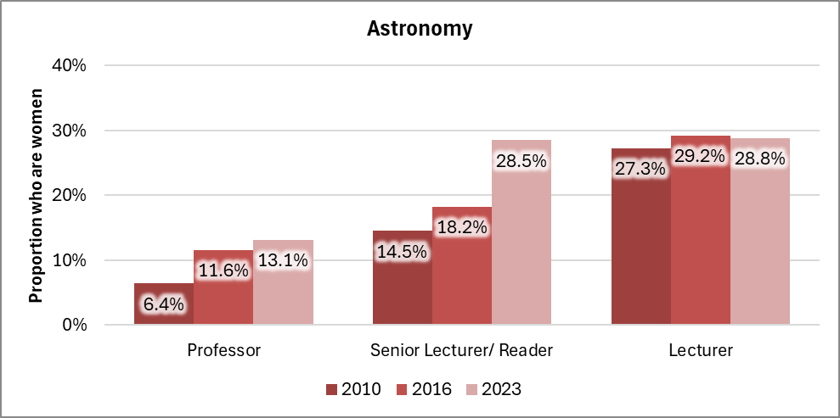
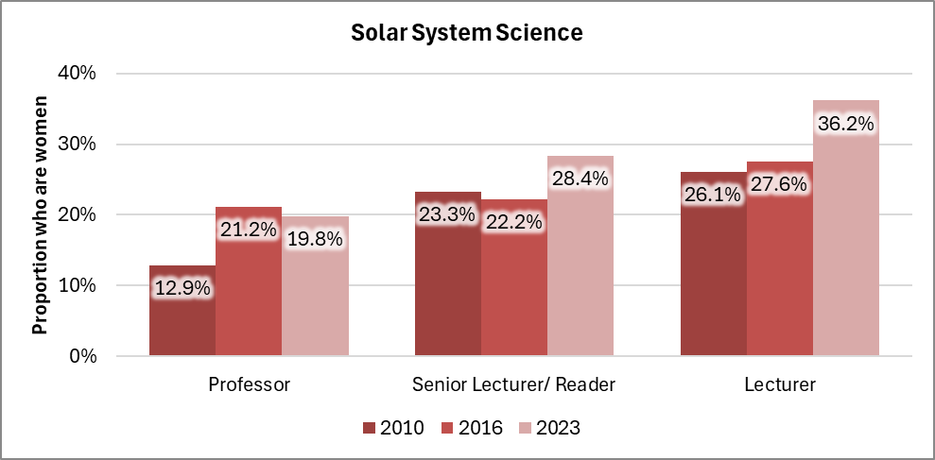
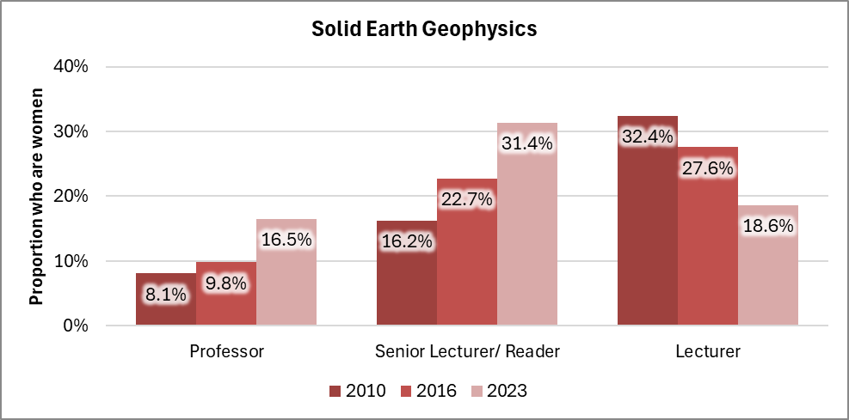
Academic Staff who are women
In 2022/23, 1,345 women and 4,505 men worked as academic staff in physics cost centres (HESA). 23.0% of physics academic staff were women.

Slide 9
Individual Questionnaires
1251 individuals started the on-line individual questionnaire, and 956 respondents provided enough information for some analysis. The 956 included:
  478 academic/research staff from 93 departments/research units in 65 institutions/research organisations;
  37 technical staff from 25 departments/research units in 23 institutions/research organisations;
  175 postdoctoral researchers from 53 departments/research units in 40 institutions/research organisations
  291 research students from 49 departments/research units in 35 institutions/research organisations began the questionnaire.
Women are more likely to have responded than men

Slide 10
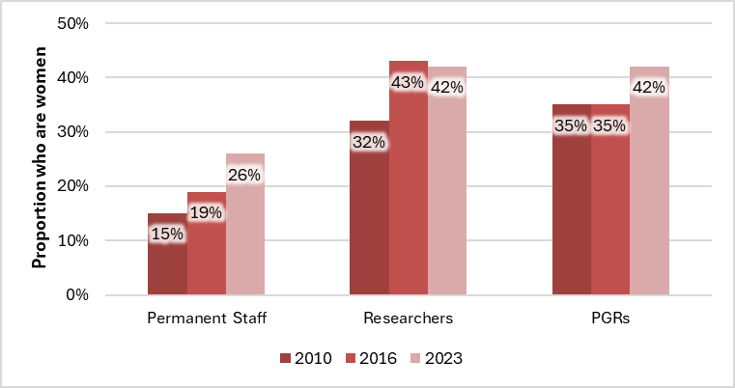
Representation of women

Slide 11
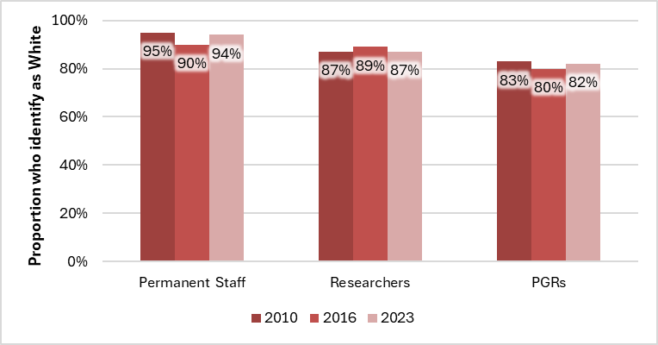
Ethnicity of respondents

Slide 12
Ethnicity of British respondents
The 2021 censuses for England and Wales, and for Northern Ireland and the 2022 census for Scotland, indicate that 83% of the population was White.

Slide 13
Ethnicity by age: Census Data

Slide 14
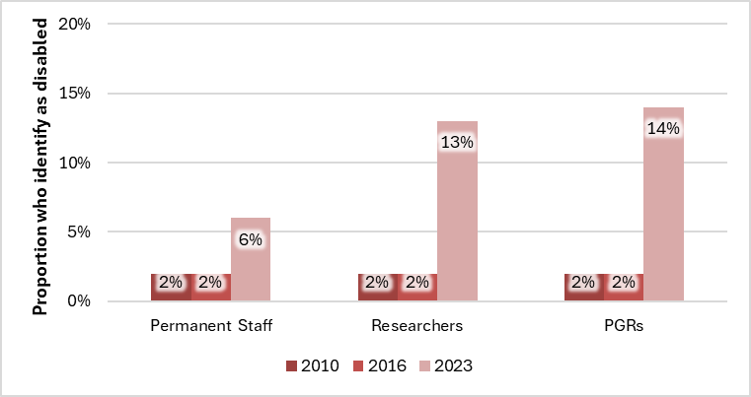
Disability
Notes:
For people aged 20 to 34, 12.2% declared a disability in the 2021 E&W Census.
For people aged 35 to 64, 17.6% declared a disability in the 2021 E&W Census

Slide 15
Religion
Notes:
Permanent Staff: 72% of White British report having no religion. There is a small, difference by sex (73% of men; 69% of women)
Researchers: 77% of White British report having no religion. No significant difference by sex.
PGR: 86% of White British PGRs report having no religion. Some differences by gender (80% of men; 75% of women; 84% of non-binary)

Slide 16
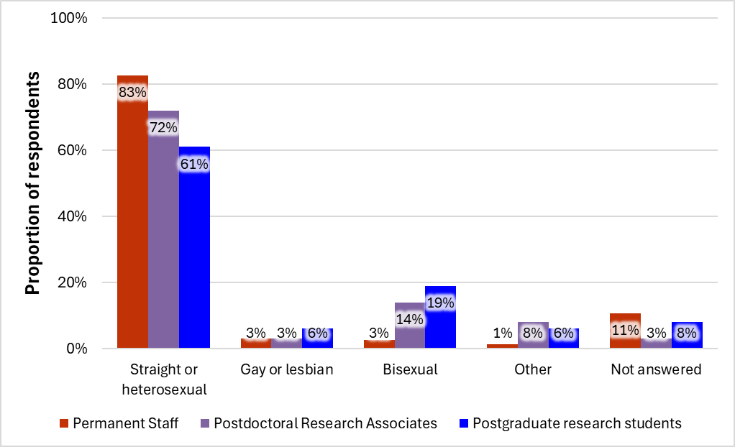
Sexual Orientation

Slide 17
Sexual orientation: Postdoctoral research associates

Slide 18
Sexual orientation: Postdoctoral research associates

Slide 19
Sexual orientation: Postgraduate Research Students
Notes:
The reasons for these differences and the significant increase in the proportion of women reporting that they are bisexual between 2016 and 2023 are unclear, but the findings are in line with data from other recent studies. For example, in a poll of results based on aggregated data from 2023 Gallup telephone surveys, encompassing interviews with more than 12,000 Americans aged 18 and older, 20.7% of Generation Z (birth years 1997 to 2005) women identified themselves as bisexual. Studies have tracked changes in sexual orientation and confirm that proportion of people identifying as LGBTQ+ in general, and as bisexual specifically, have risen significantly recently and suggest that the norms associated with sexuality are socially negotiated and changeable.

Slide 20
Sexual orientation: Postgraduate Research Students
Notes:
The reasons for these differences and the significant increase in the proportion of women reporting that they are bisexual between 2016 and 2023 are unclear, but the findings are in line with data from other recent studies. For example, in a poll of results based on aggregated data from 2023 Gallup telephone surveys, encompassing interviews with more than 12,000 Americans aged 18 and older, 20.7% of Generation Z (birth years 1997 to 2005) women identified themselves as bisexual. Studies have tracked changes in sexual orientation and confirm that proportion of people identifying as LGBTQ+ in general, and as bisexual specifically, have risen significantly recently and suggest that the norms associated with sexuality are socially negotiated and changeable.

Slide 21
Children: Permanent Staff

Slide 22
Children: Permanent Staff by Age
Notes:
The childless rates of women by birth year do vary. 2022 Data are available for women born in 1920 onwards. The assumption is that women’s childbearing years are up to the age of 45. Childless rates for women born in 1953 onwards (i.e. aged 70 in 2023) gradually increase from 15% peaking at 20% for women born in the early 60s, before falling to 18% for women born in 1975. Thereafter, childless rates increase as birth year increases such that for women born in 1983 the childless rate is 20%, those born in 1993, 64% are childless, and those born in 2003, 99% are childless.
Childbearing for women born in different years, England and Wales: 2022, Office of National Statistics

Slide 23
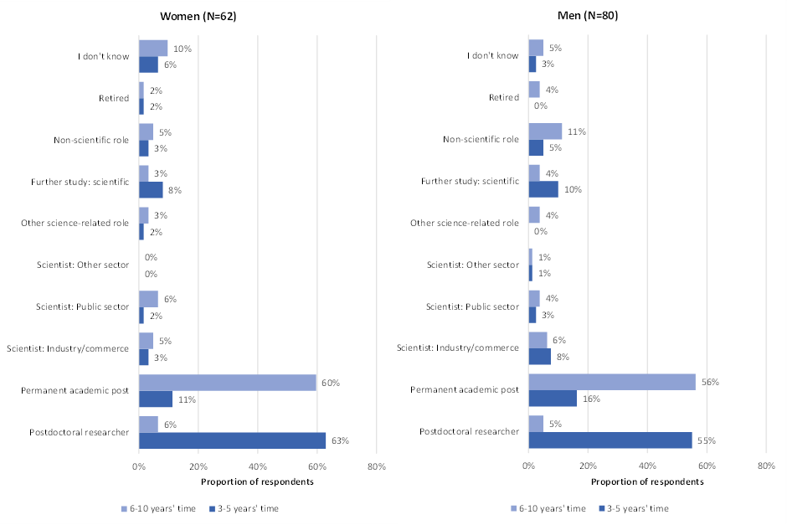
Postdoctoral research associates: most likely roles

Slide 24
Postgraduate research students: most likely roles

Slide 25
Proportions of time spent on different activities by Postdoctoral Research Associates

Slide 26
Proportions of time spent on different activities by Professors

Slide 27
Proportion of research effort at various wavelengths by permanent staff

Slide 28
Astronomy Research Areas

Slide 29
Galactic/extragalactic Research sub-Fields
Stellar Research sub-Fields

Slide 30
Cosmology Research sub-Fields

Slide 31
Solar System Science Research Areas
Planetary Research sub-Fields

Slide 32
Facilities used by permanent staff

Slide 33
Thank you
Sean McWhinnie
Tel: 01380 871213
Email: sean.mcwhinnie@oxfordresearchandpolicy.co.uk
Web: oxfordresearchandpolicy.co.uk

